Slide 1
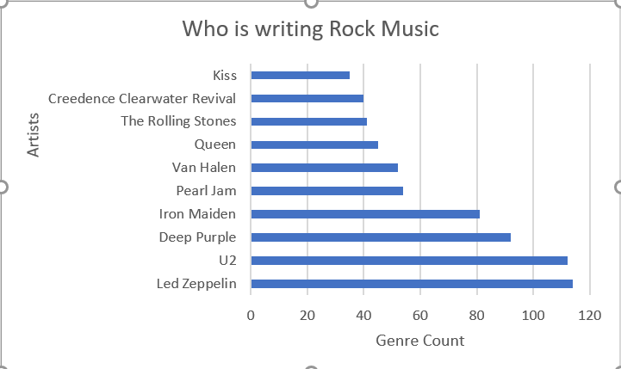
Who is Writing the Rock Music
<visualization>
As per the visualization we can see that Led Zeppelin has the most count of rock genre followed by U2 so that , these artists should be contacted for the concert.

Slide 2
Countries Purchase of Music for Rock Music
The visualization depicts the purchases by countries for Rock Music. USA is leading followed by Canada. This visualization helps to narrow down the target market which is North America in this case.

Slide 3
How much time does a song have?
<visualization>
From the visualization we can clearly see the average time of most songs is around <3000000 milliseconds and a large number of songs are around <1000000 seconds.

Slide 4
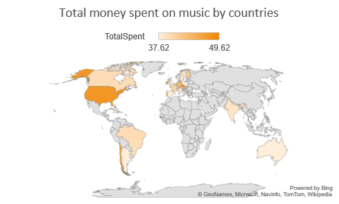
Money spent on music by countries
We could clearly see from the visualization countries in North America like USA and most of the European countries spent the most amount on music.

